Slide 1
Training SQL with ChatGPT
Yan Sun, data scientist co-op
yan.sun11@merck.com

Slide 2
Goals
We will apply the latest LLM (ChatGPT) with fusion of structured knowledge of SQL databases to automatically generate SQL queries.
Automatic generation of SQL queries will facilitate the researches on cohort studies.
Large LLM will help non-experts to better understand the functionality of SQL codes.

Slide 3
Introduction of ChatGPT 4.0
ChatGPT 4.0 has the ability to learn database structure.
Integration of database knowledge:
Query generation
It is still difficult to understand the complicated structure of health dataset.

Slide 4
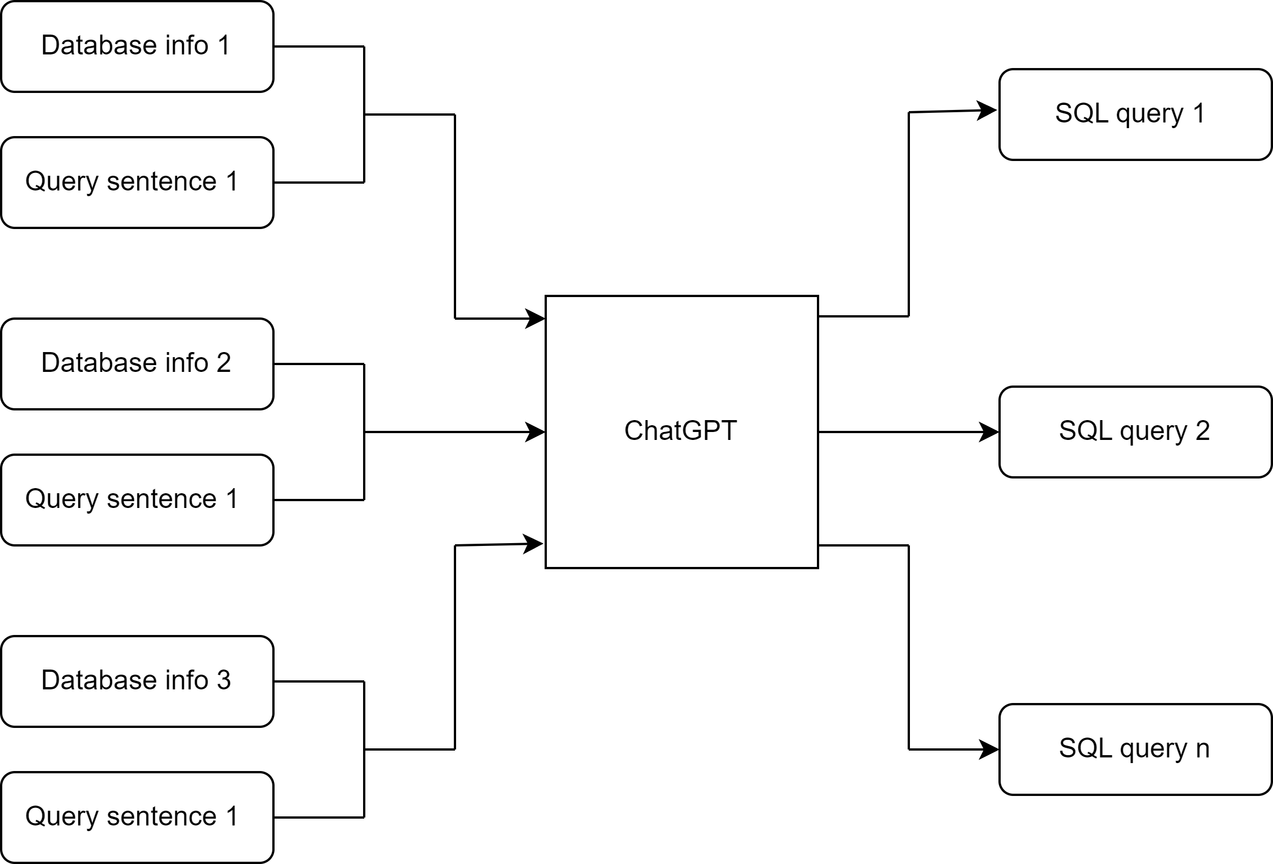
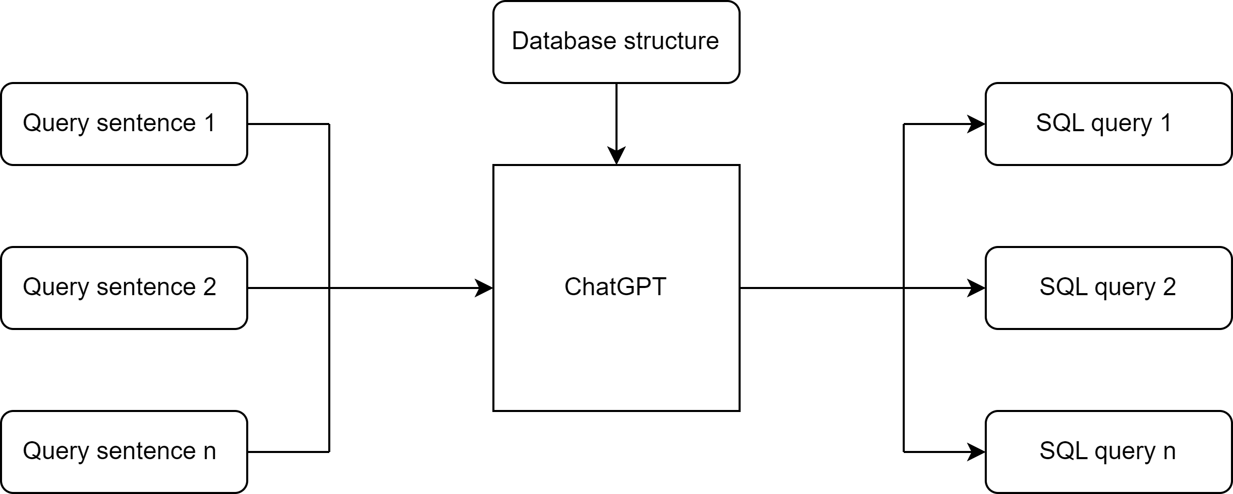
Structure
Unified structure knowledge
We fine tune ChatGPT using the entire information of the database
Distributed structure knowledge
For each query, relevant input columns are provided as input

Slide 5
Current progress & future work
We have created a small-size training dataset, with inclusion-exclusion criteria as input and corresponding SQL queries as output.
Next step we will focus on training ChatGPT using database information, including columns names and their explanations.

